Slide 1
Tekton

Slide 2

Engineers Life “Desired State”

Slide 3

Engineers Life “Current State”

Slide 4
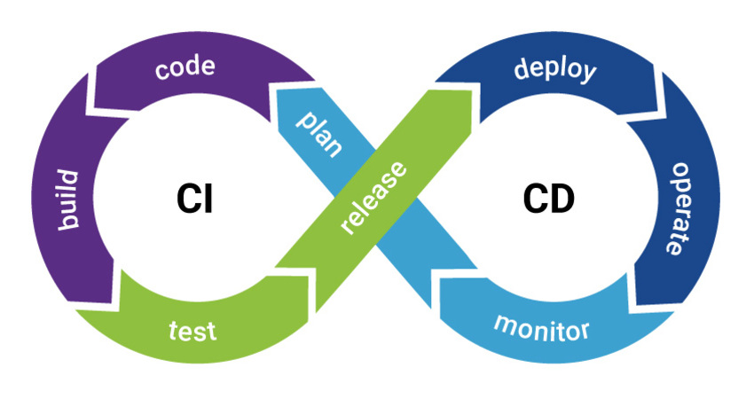
CI/CD

Slide 5

CI

Slide 6
Tekton [Details]
Github = https://github.com/tektoncd
website = https://tekton.dev/
Tekton cli = tkn
Tekton Triggers
Tekton Catalog = https://hub.tekton.dev/
Tekton Dashboard

Slide 7
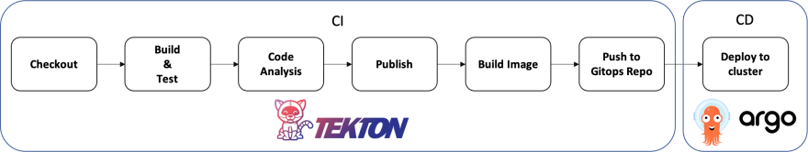
Tekton(Greek) (Builder)
CDF(Continuous Delivery Foundation) Graduated

Slide 8
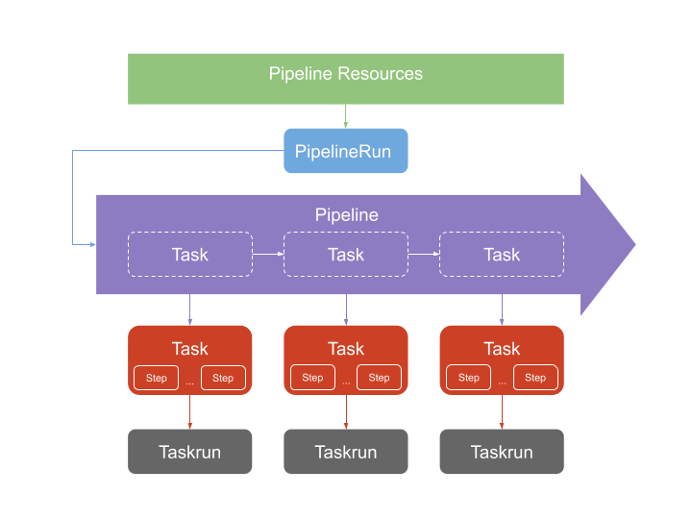
Tekton

Slide 9
Tekton CRD
Task - defines a series of ordered Steps
ClusterTask – defines a series of ordered Steps for entire Cluster
TaskRun - instantiates a specific Task
Pipeline - defines a series of ordered Tasks
PipelineRun - instantiates a specific Pipeline

Slide 10
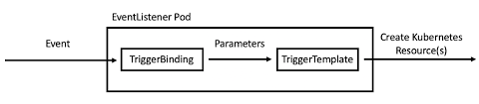
Tekton Triggers

Slide 11
Triggers CRD
EventListener - listens for events at a specified port on your Kubernetes cluster. Specifies one or more Triggers
Trigger - specifies what happens when the EventListener detects an event. A Trigger specifies a TriggerTemplate, a TriggerBinding, and optionally, an Interceptor

Slide 12
Triggers CRD (contd)
TriggerBinding - specifies the fields in the event payload from which you want to extract data and the fields in your corresponding TriggerTemplate to populate with the extracted value
TriggerTemplate - specifies a blueprint for the resource, such as a TaskRun or PipelineRun, that you want to instantiate and/or execute when your EventListener detects an even

Slide 13
Tekton example github
https://github.com/arunvel1988/K8S-Paathshala-Pune-Tekton

